Slide 1
Changing Face of Diversity
Alorica Global Human Resources
Jeff Luttrell, SPHR, SHRM-SCP

Slide 2

About me
SPHR, SHRM-SCP
Senior Director of Talent Acquisition at Alorica
Southeast Region MAC Rep, Director Emeritus, NCSHRM State Council, Talent Acquisition Expertise Panel
Past President for Raleigh-Wake HR Management Association
Over 20 years in recruitment (agency and corporate, high volume, executive, technical and professional)
Lead diverse teams all over the world (over 50 locations/200 people)

Slide 3

Diversity and Inclusion or Inclusion and Diversity
Things are different today – not only about race anymore.

Slide 4


Slide 5

What do you see?

Slide 6
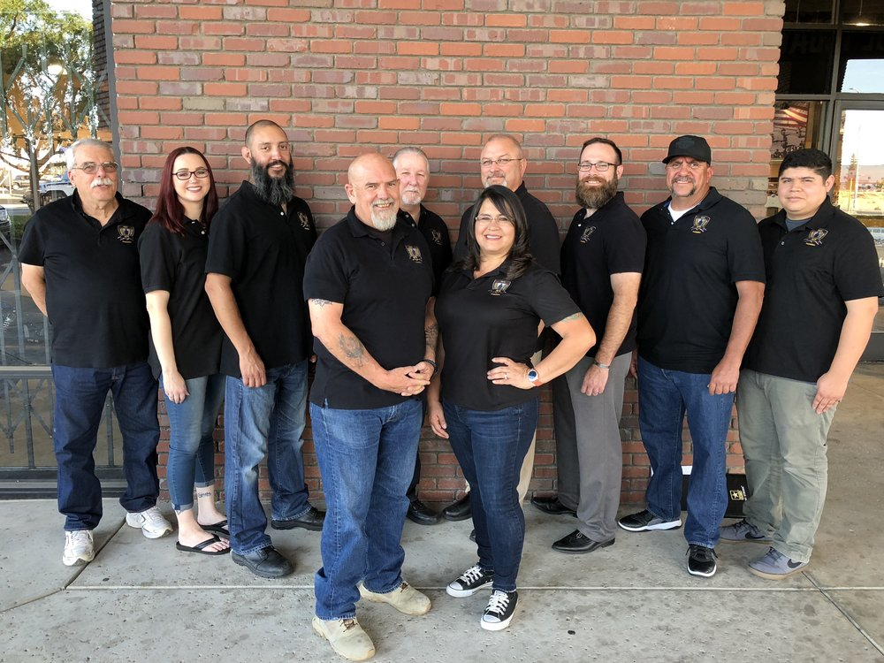
What do you see?

Slide 7

What do you see?

Slide 8

What do you see?

Slide 9

What do you see?

Slide 10

What do you see?

Slide 11

What do you see?

Slide 12


What else?
Age, Gender, LGBTQ, Veteran, Ex-offender, Other Minorities

Slide 13

Why??

Slide 14

Multi-cultural workforce
Still a huge component
Demographic shifts
Talent shortage
Clients demand it
Competition
Changing economy
Unemployment
Globalization
Diversity of thought
It’s the right thing to do

Slide 15
Statistics
There are over 20 million veterans
Over 600,000 people are released from state or federal prisons each year
47 million Americans are over age 65
Almost 50 million people in the US have a disability –
half of those are not severe

Slide 16
Statistics
Companies with a diverse workforce are 35 percent more likely to outperform those without diversity initiatives. From https://blog.seekout.io/diversity-statistics-2018/
70+ companies published gender diversity hiring targets in 2017. From https://blog.seekout.io/diversity-statistics-2018/
Employees are demanding their leaders take a political stance – more than 50% in recent studies. From https://medium.com/awaken-blog/2017-2018-trends-in-diversity-and-inclusion-ffd33ca9e5b6
5% of Fortune 500 CEOs are women (Forbes)
Decreases in black CEO leadership and the lowest concentration of black leaders since 2002. (Forbes)

Slide 17
How do you build your case?

Slide 18
You must have leadership buy-in
It must be part of your culture
All levels must see importance
Metrics and value proposition

Slide 19
Getting leadership support
Quantify cost of open positions
Quantify cost of attrition
Reduced cost per applicant/hire
Satisfaction survey scores
SHOW THEM THE VALUE

Slide 20
Developing Your D&I Plan
Data
Strategy
Implementation
Evaluation
from SHRM
https://www.shrm.org/resourcesandtools/tools-and-samples/how-to-guides/pages/how-to-develop-a-diversity-and-inclusion-initiative.aspx

Slide 21
How do you do it?
Diversity Strategy in Recruitment
Bias in Screening
Mentorship/ Development
Leadership team
Marketing/
Branding
Social Media
Community Partnerships
Watch Referrals
Great article on SHRM website (Feb 24, 5 Steps to Improve Diversity Recruiting, Pamela Babcock

Slide 22

Inclusion and Diversity

Slide 23





Bottom Line
Diversity and inclusion matters to business today.

Slide 24
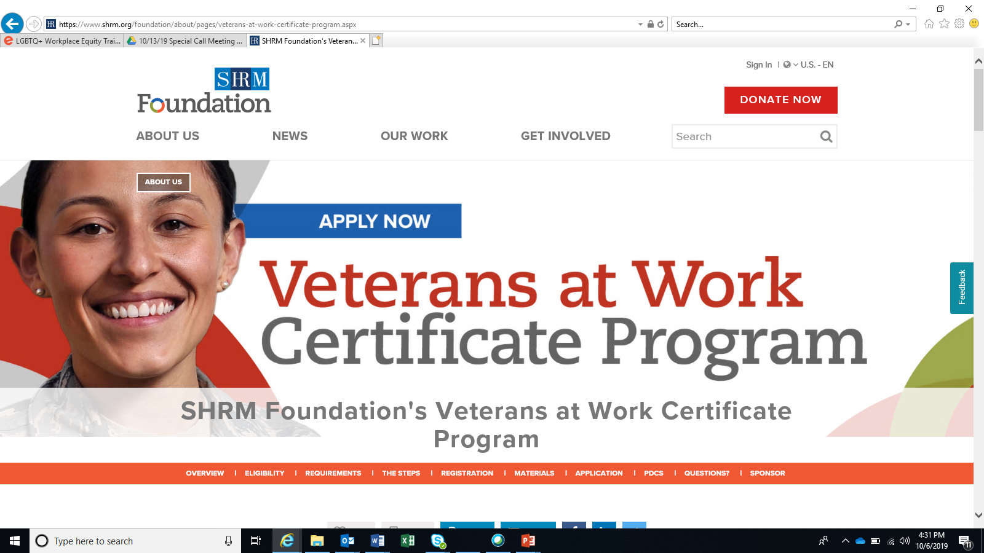
Other Resources and Tools

Slide 25
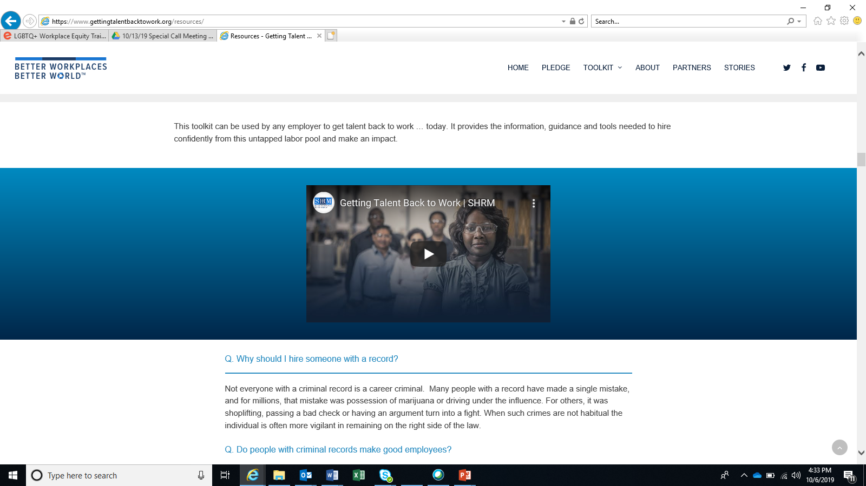
Other Resources and Tools

Slide 26
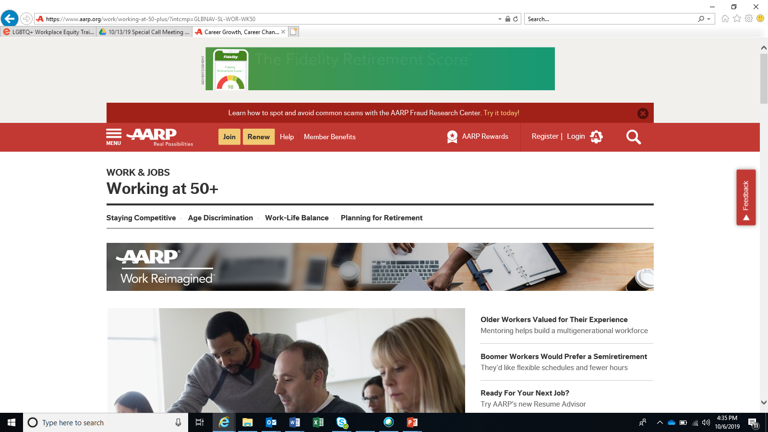
Other Resources and Tools

Slide 27
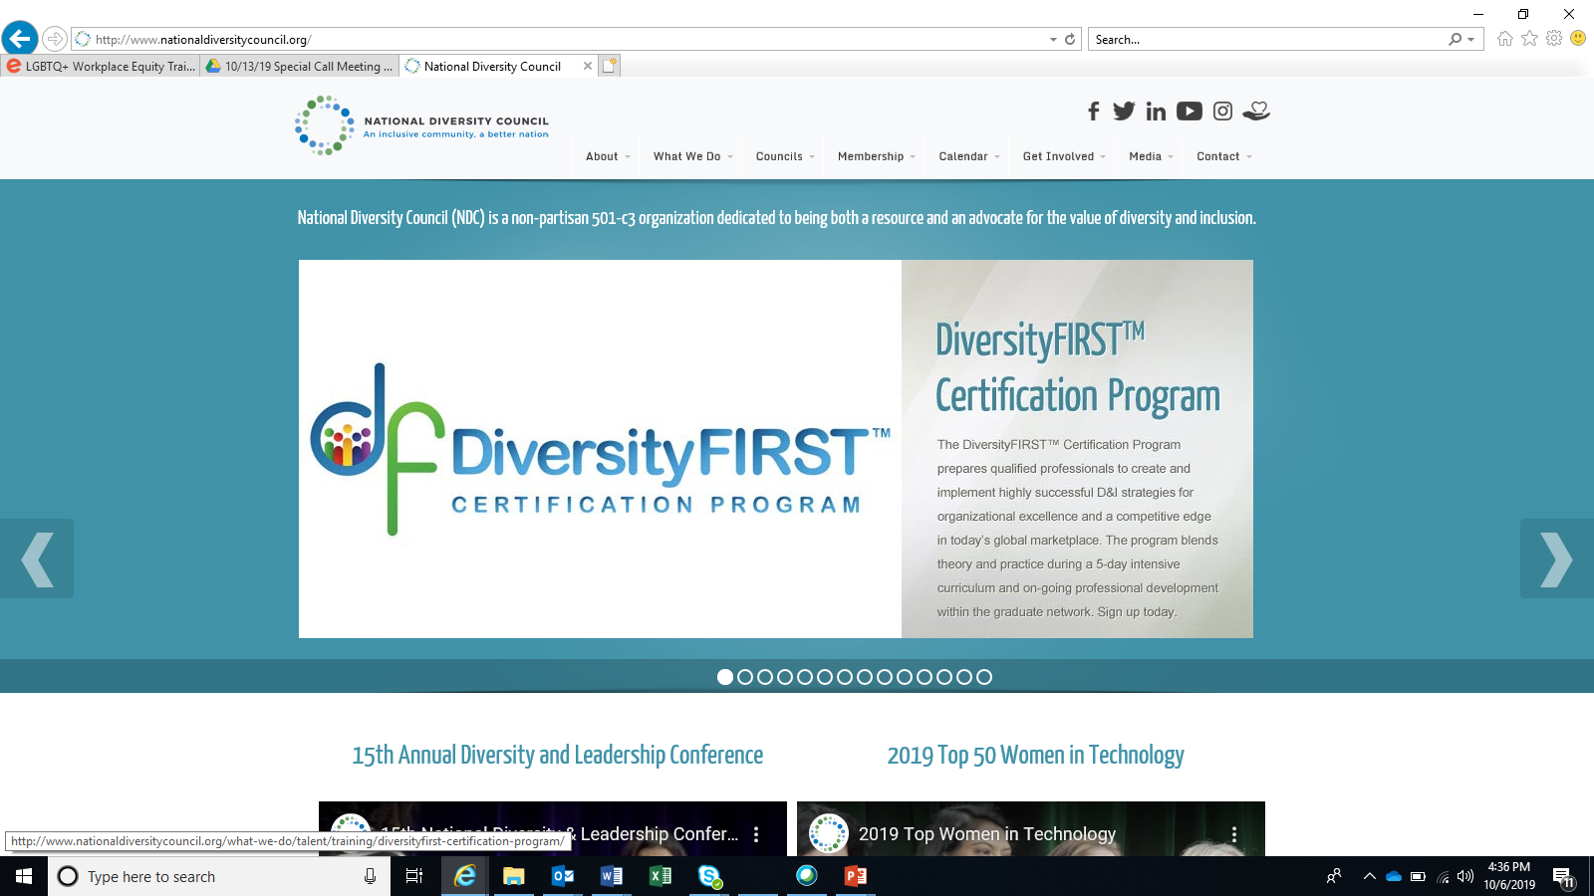
Other Resources and Tools

Slide 28

Questions & Discussion

